Slide 1
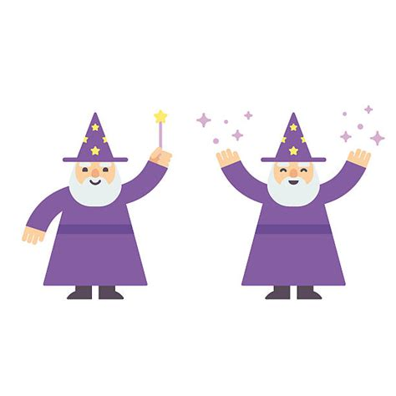
Music Wizard
Lizao Wang, Annie Liu, Vera Ye
Notes:
大家一起

Slide 2
Overview
This program prompts the user to answer a short series of
seemingly irrelevant questions and make guesses about the name of a song that the user likes (with hints offered along the way), and eventually makes a prediction of the piece of music that is the user’s hit!
Notes:
汪立早

Slide 3
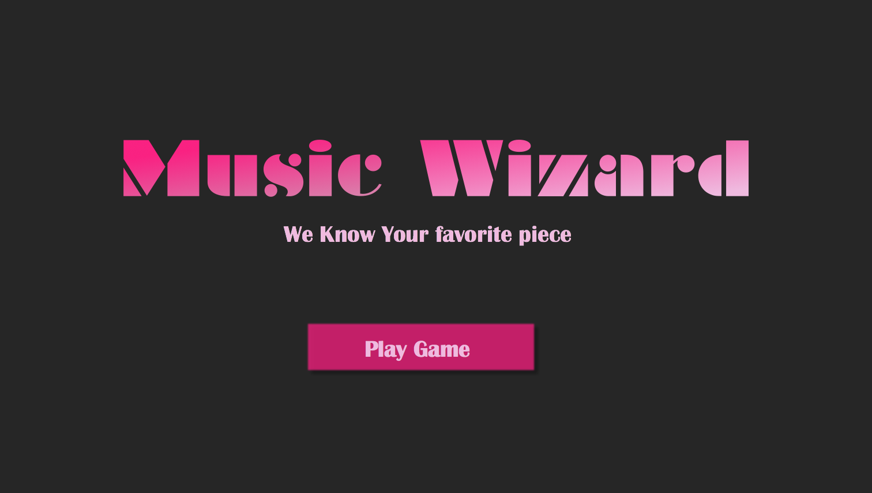
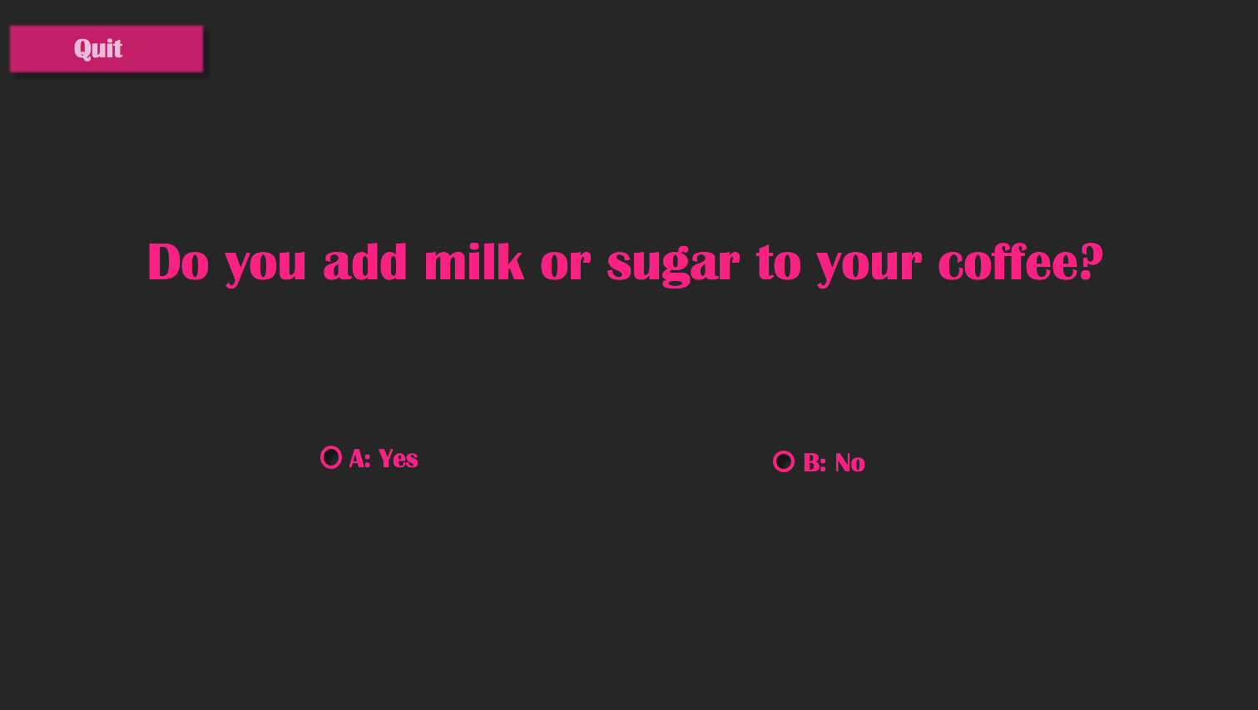
Overview
Landing Page:
Initialize the game and display the “Play Game” button for user to enter the game.
Question Page:
Answer a series of questions, which leads the user to a resulting song.
Notes:
汪立早

Slide 4
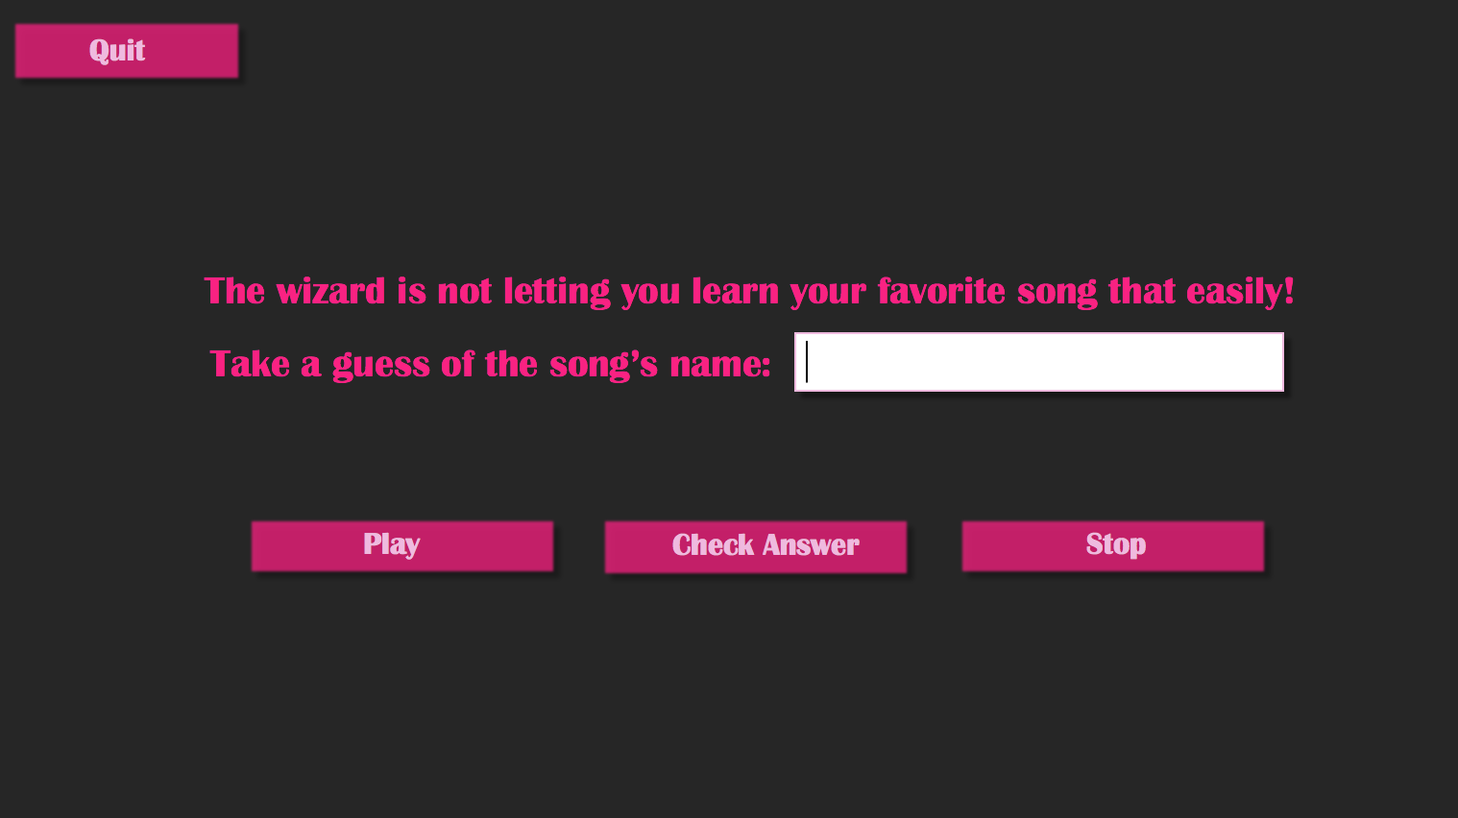

Overview
Guessing Page 1:
Prompt the user to make a first guess of the song’s name.
Guessing Page 2:
Provide the user with an encrypted song name as one hint.
Notes:
汪立早

Slide 5

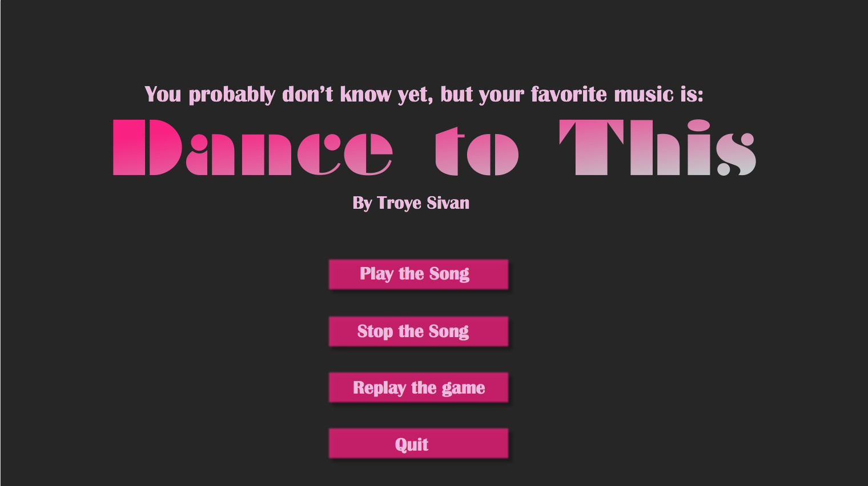
Overview
Guessing Page 3:
Provide the user with another encrypted song name as the last hint.
Final Page:
Display the song name with the image of the CD cover of the song and different options for the user to proceed.
Notes:
汪立早

Slide 6
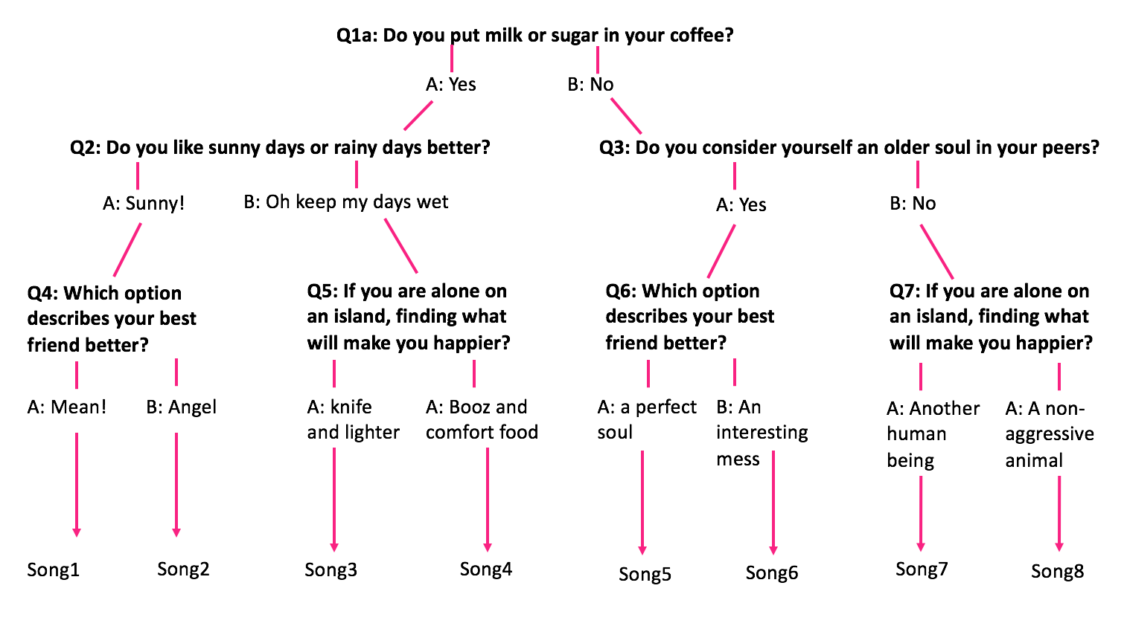
Expert System: Decision Tree
Notes:
叶语童

Slide 7
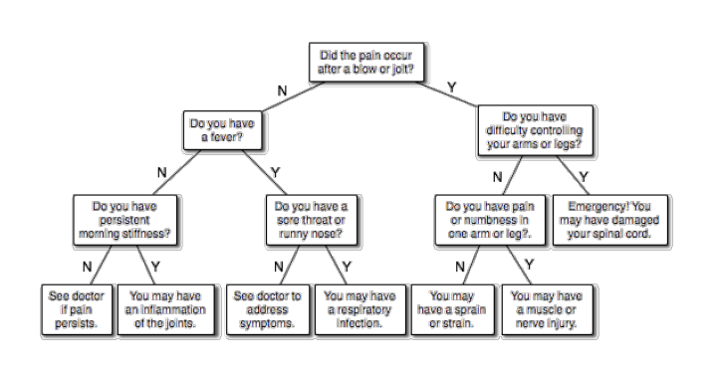
Choice of data structures
Tree
Linked Binary Tree:
used to represent a series of questions that the user would be prompted to answer;
the user would select their desirable answer from two possible choices, either A or B, and continue to do so until no more questions show up;
Lec.19 TreeImplementations
Notes:
叶语童

Slide 8
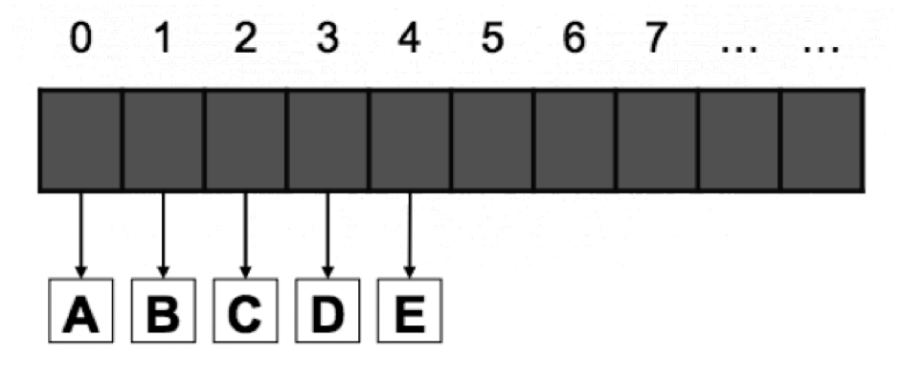
Choice of data structures
Queue
Array Queue:
used to hold information about the encrypted names of the songs in the database;
each queue contains two different encrypted songName Strings and one imageFile String which is a string representation of the name of the CD cover image file.
Lec.11 Queues
Notes:
叶语童

Slide 9
Main Classes
musicBinaryTree
Contains the Linked Binary Tree:
Beginning with answering question at the root, the user would select the desirable answer from two possible choices, A or B, and continue to do so until no more questions show up.
encryptedNamesQueue
Contains an array of queues storing the encrypted names of the songs:
A queue for each song, in which contains the two encrypted songName Strings and one imageName String.
Notes:
刘雅馨

Slide 10
Main Classes musicWizardPanel
landingPage:
Displays the name of this project on the screen, the JLabel “We know your favorite piece” under it, and a JButton “Play”.
questionPage:
Displays each question sequentially with two JRadioButton (choice A/B) underneath, and a JButton “Quit” on the top right corner .
guessingPage:
Displays a JButton to play the music, a JButton to stop the music, and a JTextField for user to enter guesses, and a JButton to check the answer.
finalPage:
Displays the CD cover of this piece of music from encryptedNamesQueue, as well as JButtons to play/stop the song or quit/replay the whole game.
Notes:
刘雅馨

Slide 11
Main Classes
usersGuess
helper class that implements the Comparable interface and imports the Scanner class:
In the duration of the game, if user input equals the name of the music, finalPage will be displayed;
otherwise, it gets encrypted strings from encryptedNamesQueue and print the hint;
after three rounds of guessing, finalPage will be automatically displayed.
Notes:
刘雅馨

Slide 12
Thank you!
Notes:
大家一起
Bring out our questions: tab vs. always changing contents
Ideas for wizard’s quesionts

